Slide 1



This is an explainer video of what is organizational culture.
ASALAM-U-ALAIKUM STUDENTS

Slide 2


What is Organizational Culture?
Organizational culture is a system of shared assumptions, values, and beliefs, which governs how people behave in organizations. These shared values have a strong influence on the people in the organization and dictate how they dress, act, and perform their jobs.

Slide 3


ORGANIZATION DEVELOPMENT

Slide 4
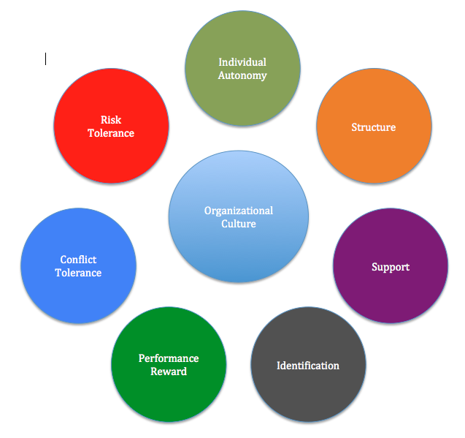
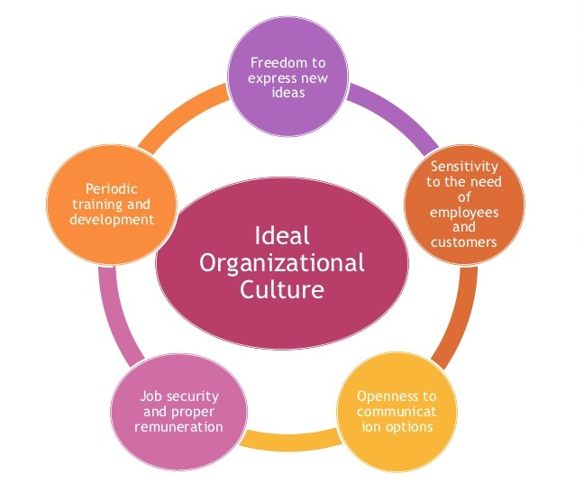
BASIC FACTORS OF ORGANIZATIONAL CULTURE

Slide 5

What makes a fantastic Culture?
A fantastic culture must have a common view of
the company’s goals and values
In order to have a better environment:
Employees must love what they are doing
And feel that it matters for something

Slide 6
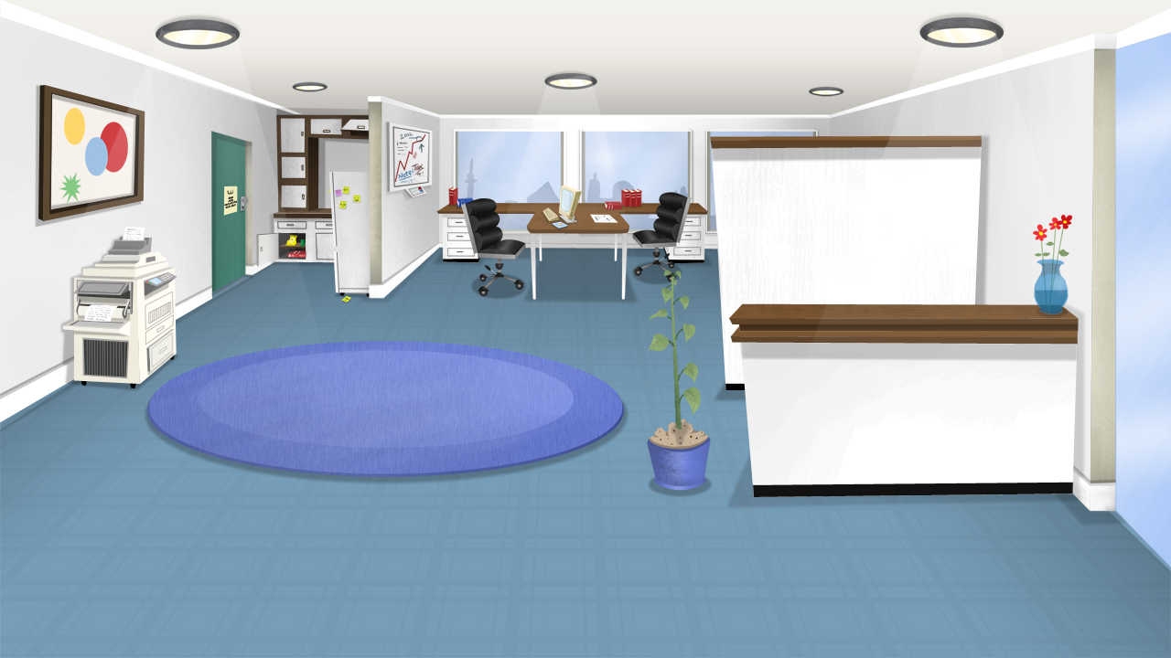


The company
should
provide an
adequate
work place
Where employees can feel
Safe and have stress free
spaces

Slide 7
Are also important to keep the interest and to continuously improve skills
Challenges
With appropriate
Training
&
Resources

Slide 8


Organizational culture can be defined as series of:
VALUES THOUGHTS RULES

Slide 9


LEVELS OF ORGANIZATIONAL CULTURE
Level 1 Social and physical environment.
Level 2 Values and labor relations.
Level 3 Internal and external problem solving.

Slide 10
HOW CAN WE IDENTIFY THE ORGANIZATIONAL CULTURE?

Slide 11


Steps to identify the organizational culture
1. First Contact
2. Culture Examine

Slide 12


3. Expert Interviews
4. Focus Group

Slide 13

5. Consulting Group Meeting

Slide 14

6. Hypothesis and Cultural Items

Slide 15


7. Results
8. Compilation

Slide 16

9. Final Report

Slide 17

THANKS FOR WATCHING
Credits
Saad Zafar
Bisma Islam
Nida Abrar
Anam Rafi

